Slide 1
Java Development

Slide 2
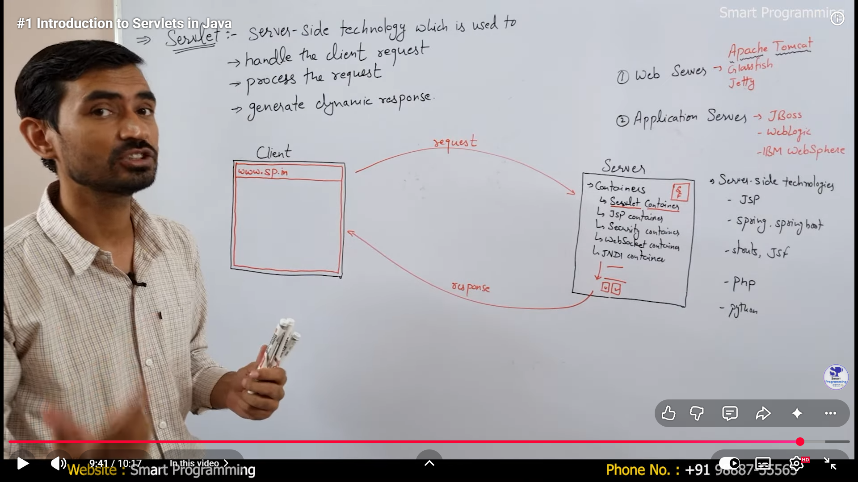

Slide 3
